Slide 1
PRESENTATION ON PHP AJAX LIVE SEARCHING.
TASK #1 FOR INTERNSHIP.
Presentation on php ajax live search.

Slide 2
CONTAINS FOUR FILES.
3 php, 1 js.
3 php files has one config.php file which creates a connection with mysql database.
Another php file contains the front end for the implementation of the topic.
And the last file is named as ajax.php which finds the required in the database in accordance with ajax script.
Js file includes jquery as well as ajax.

Slide 3
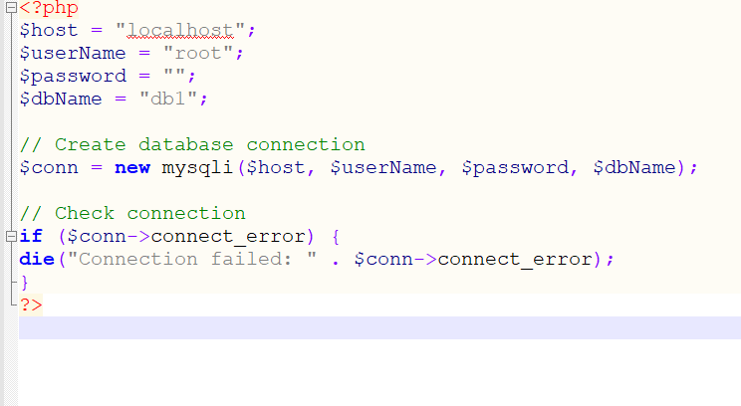
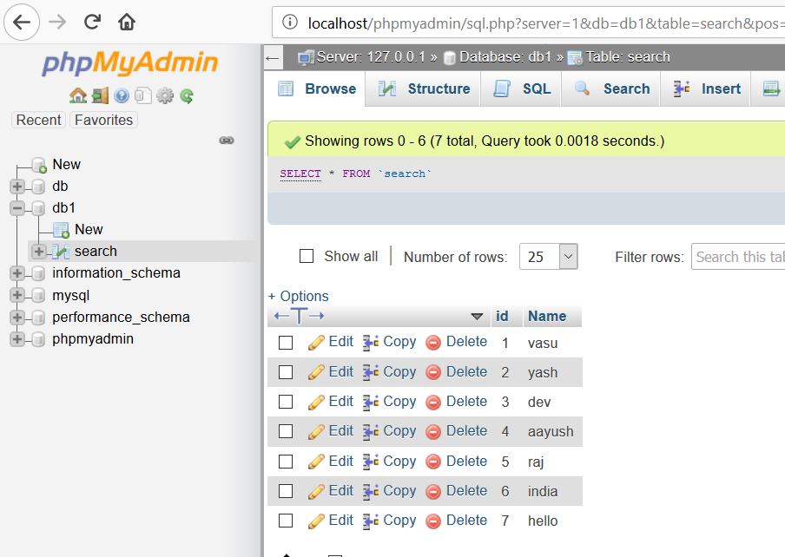
Config.php
The above code snippet creates a connection with database “db1”.

Slide 4
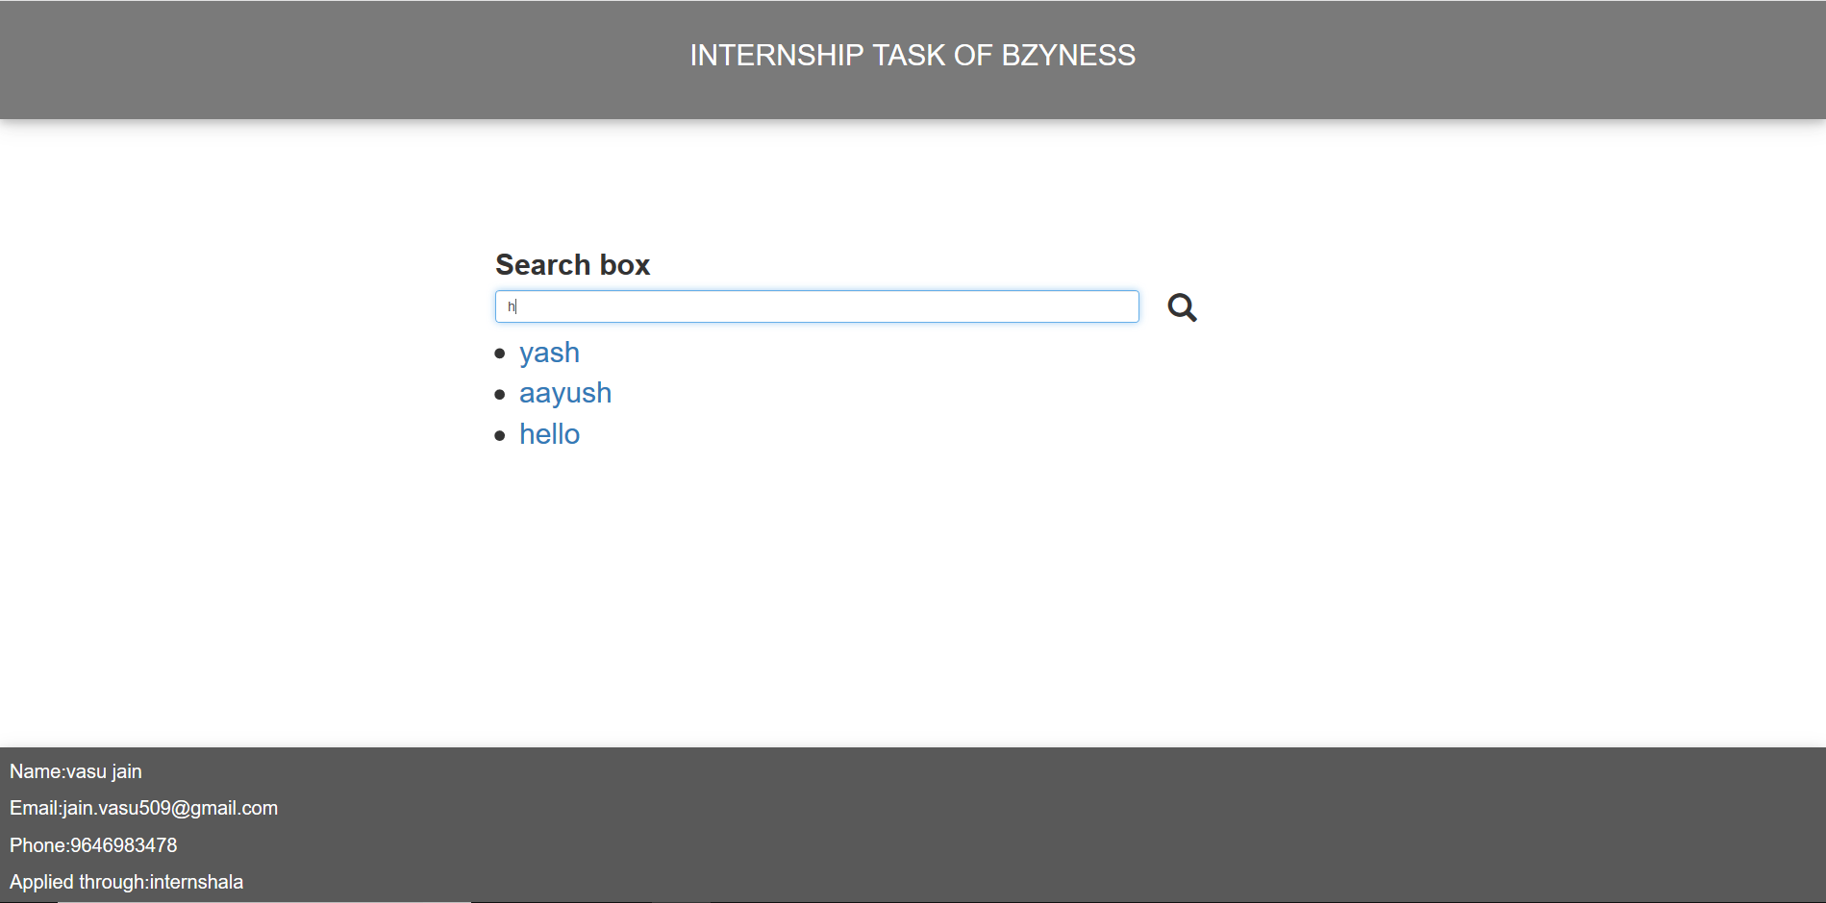
Search.php
This file includes bootstrap and css for styling of the page.
Bootstrap file and script.js file is included in the head tag.
Code snippet cannot be attached because of large lines of code please refer to implementation part.
One search bar is created in which we search through the names in database

Slide 5
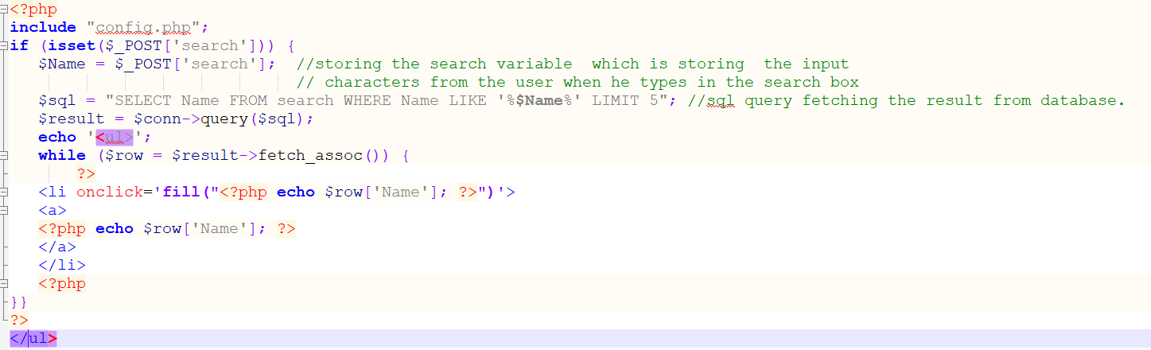
Ajax.php code explanation
These lines of code take the value from the search box.
Through the sql query all the results has been fetched which look like the characters typed by user in search box.
fill() function is declared in script.js file.

Slide 6
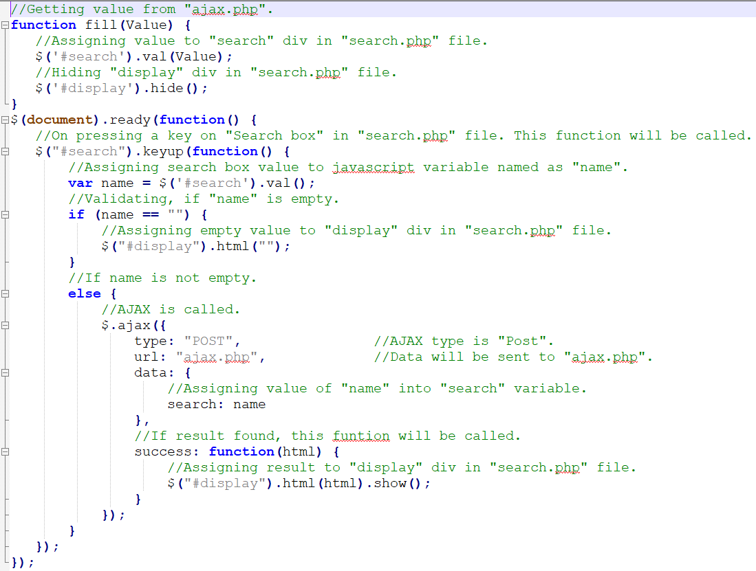
Script.js code explained
Fill function contains two jquery functions for id’s search and display which assign value to search div and hide the display div in search.php
Comments in code snippet explain each line of code briefly.

